Slide 1
Intune - Programmatically: Provision Intune environment using Plaster & Azure DevOps.
Ben Reader
Notes:
This is the slide shown before the presentation starts. When you are ready to go, tell the video operator to start the recording, and click to the next slide.

Slide 2
5
Video operator, did you start the recording?
Notes:
[REQUIRED SLIDE]
These slides are mandatory and help us with video post-processing. Please keep them as they are.

Slide 3
4
Notes:
[REQUIRED SLIDE]

Slide 4
3
Notes:
[REQUIRED SLIDE]

Slide 5
2
Notes:
[REQUIRED SLIDE]

Slide 6
1
Notes:
[REQUIRED SLIDE]

Slide 7
Intune - Programmatically: Provision Intune environment using Plaster & Azure DevOps.
Ben Reader
Notes:
This is your opening. Now the stage is yours!

Slide 8
How to insert your Twitter handle
1. On the Insert tab, select Header & Footer.
2. On the Slide tab, check the Footer box.
3. In the box below Footer, type your Twitter handle (e.g. @PSConfEU).
4. To prevent the footer from appearing on the title slide, check the Don't show on title slide box.
5. Click Apply to All button.

Slide 9
This Session
Learn how to utilize CI/CD pipelines in Azure DevOps, Microsoft Graph & PowerShell Plaster Templates to deploy pre-built Intune “Profile Modules“.
Notes:
Please invest some time to reconsider your session: what is it that audience can get out of it? Try and be as precise as you can. If you are showing solutions, then focus on “how to”. If you present about a general technology, you’ll want to stick to “Be able to” or “Understand why/how”.

Slide 10
Agenda
Overview
What is Microsoft Graph
What are “Profile Modules“
How can we use Azure DevOps to automate and manage Intune devices
Notes:
Psconf.eu is about demos and code. Try and minimize use of text slides

Slide 11
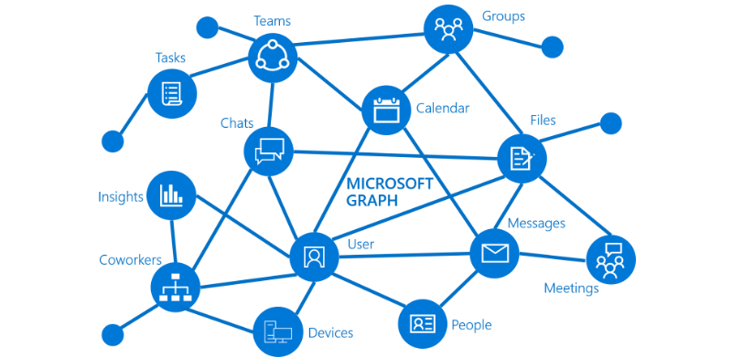
What is Microsoft Graph?
Restful API
Easy access to data for Intune / Office 365
Extensible
One endpoint to rule them all!
Notes:
Psconf.eu is about demos and code. Try and minimize use of text slides

Slide 12
What are “Profile Modules”?
Not an official term – just a concept
Common device configurations stored in JSON files
Pick and choose which settings your client requires
Speed up the initial provisioning of Intune
Enjoy your job!

Slide 13
Demo Title

Slide 14
Summary
Configuring Intune is easy
Graph is your friend – spend time learning it
PowerShell makes Intune amazing
Start out small
Use the defaults until you need to change
Introduce small configuration changes overtime
Notes:
Sum up your key messages

Slide 15
https://github.com/tabs-not-spaces/Intune-Plaster-Build
Notes:
[REQUIRED SLIDE]
Make sure you provide all materials that audience needs to reproduce your demos.
Either upload them as a PowerShell module to www.powershellgallery.com (preferred for reusable functions)
Or, upload them to our github repository (ask the girls at the info desk to provide you with access)
Or, upload them to your own github repository
Please make sure all materials are available by the time your presentation starts, or at minimum upload them right after your presentation

Slide 16
Notes:
[REQUIRED SLIDE]
If you sticked to your timing, you now have 15 min left for Q&A. If you missed your timing, you will have to leave the room when your slot is over. In this case, invite your audience to the coffee break and offer to cover questions there.
IN ANY CASE please point your audience to the conference app and the session voting. By the time the conference opens, the eventraft app *should* have the option to vote on sessions.
Please MAKE SURE you leave your room when your slot is over. The next speaker would like to set him/herself up and get everything up and running.

Slide 17


Ben Reader
End User Compute Automation Specialist
Website: powers-hell.com
Github: github.com/tabs-not-spaces
Notes:
Do not EVER discuss this slide during your presentation. Please do not take presentation time to talk about yourself more than just a few introductory sentences. Instead, invite interested audience to the coffee break, and then talk about yourself, your job, your services, etc.
Use this slide to sum up your details. It will be part of the conference materials and recorded videos.

